Slide 1
UNIT-I
Introduction

Slide 2
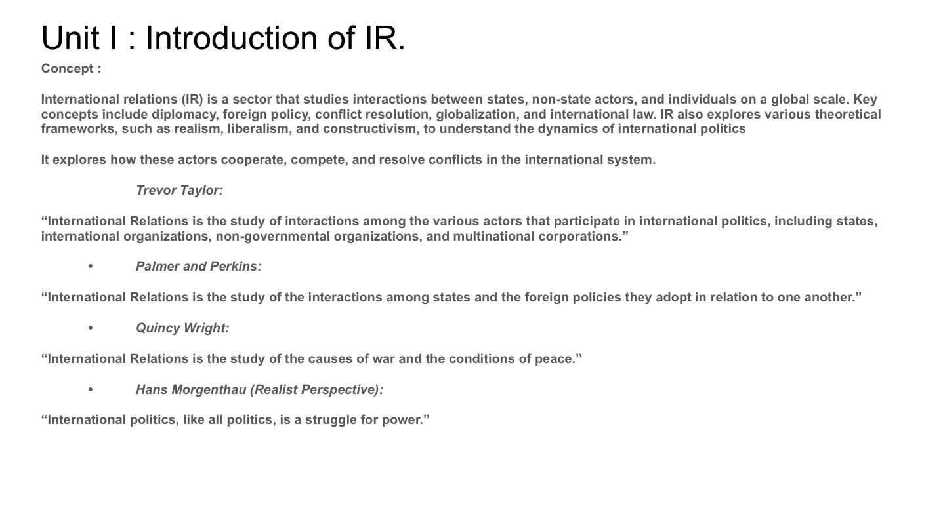

Slide 3
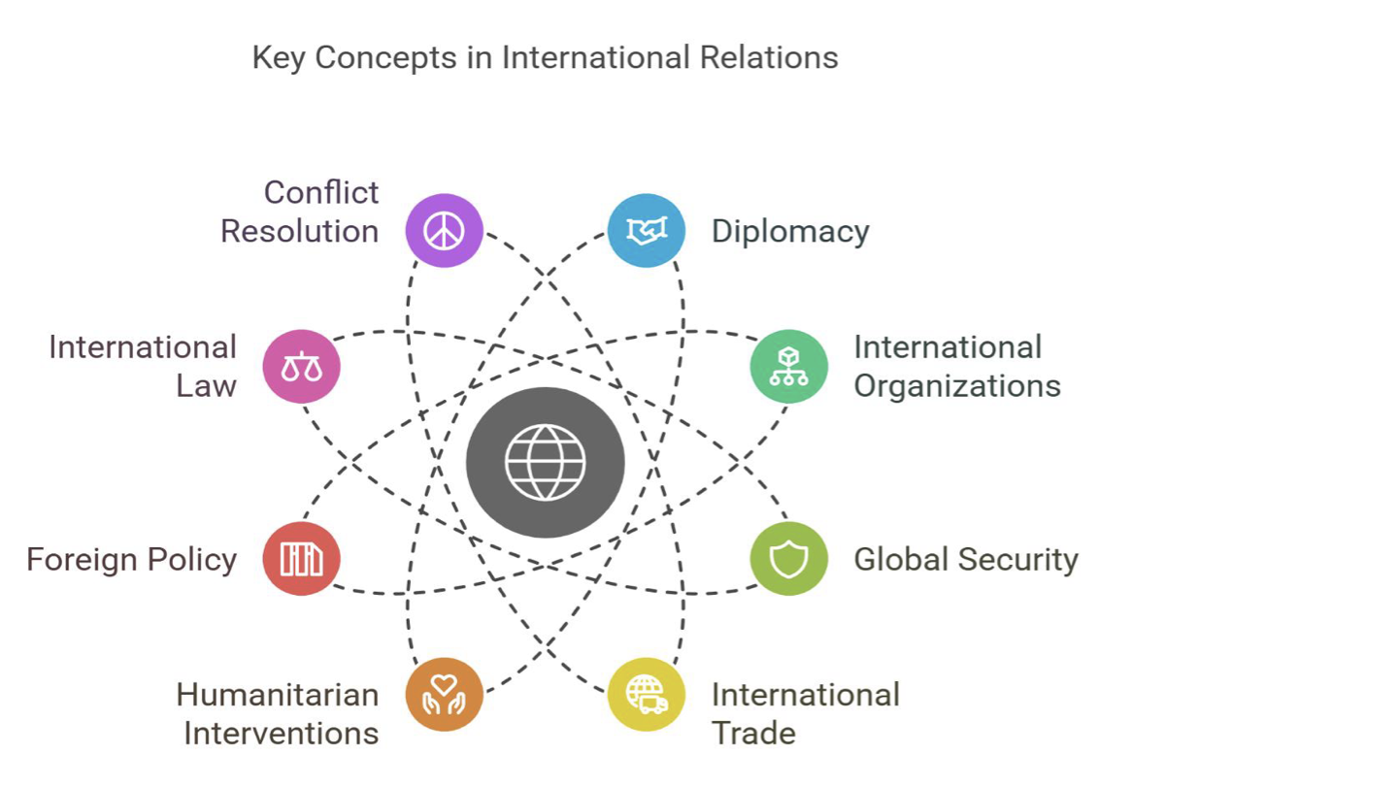

Slide 5
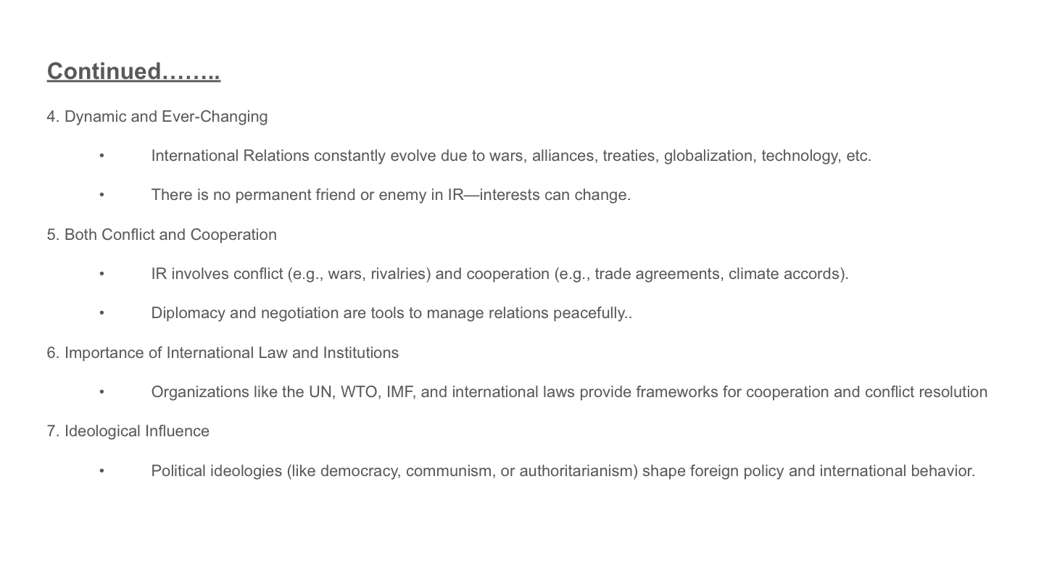

Slide 6
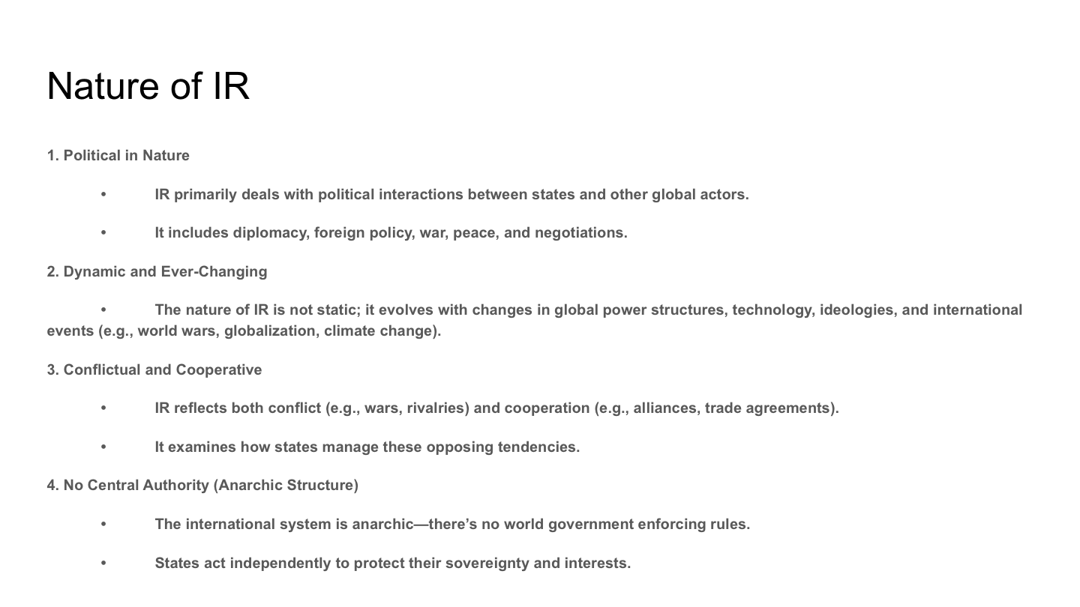

Slide 7
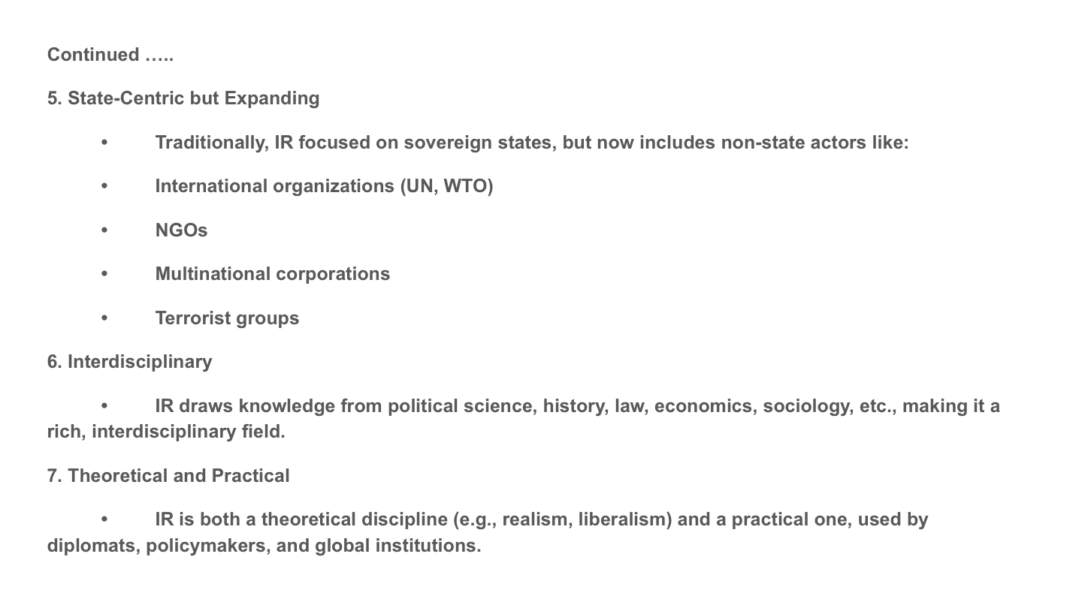

Slide 8
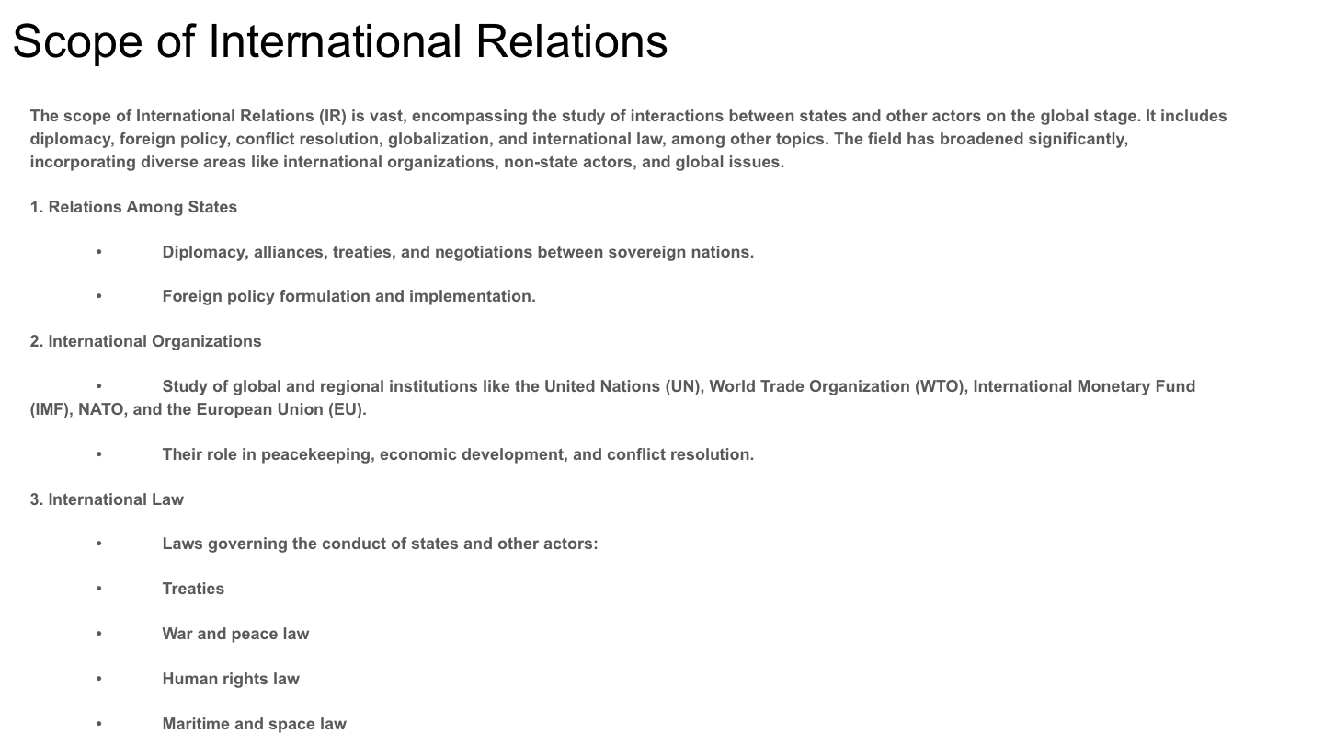

Slide 9
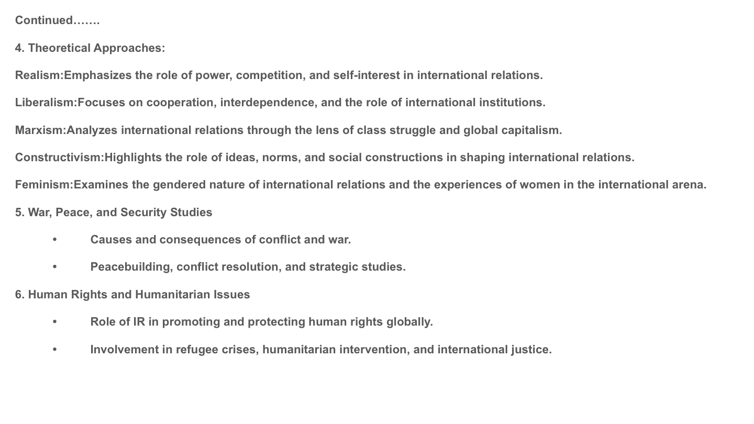

Slide 10
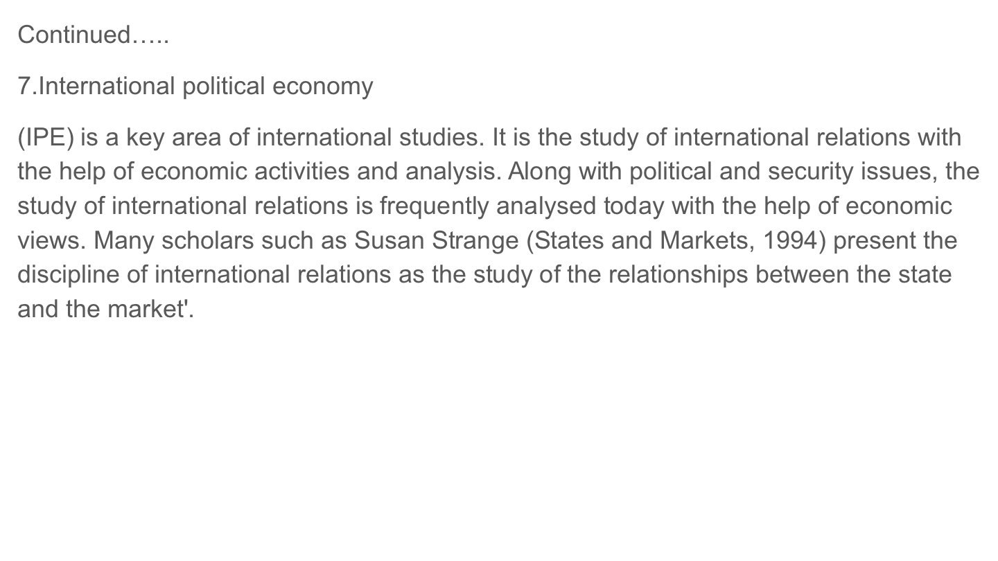

Slide 11
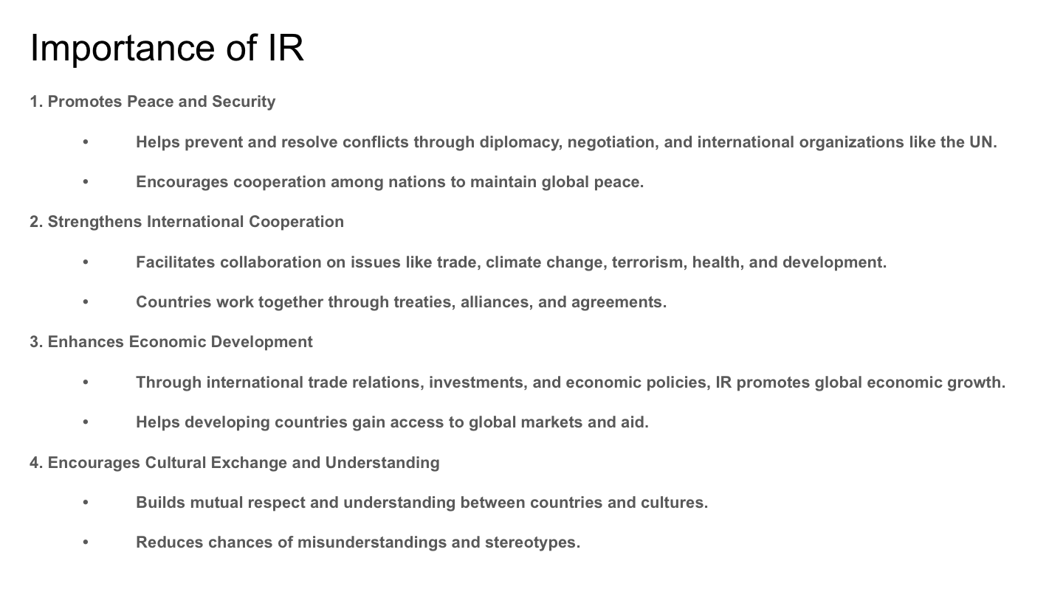

Slide 12
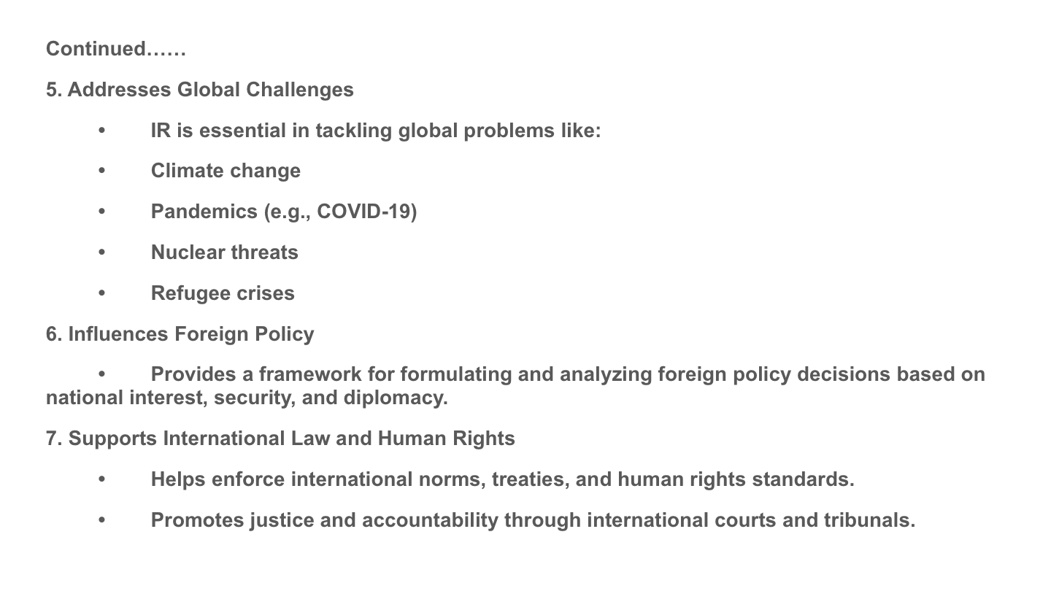

Slide 13
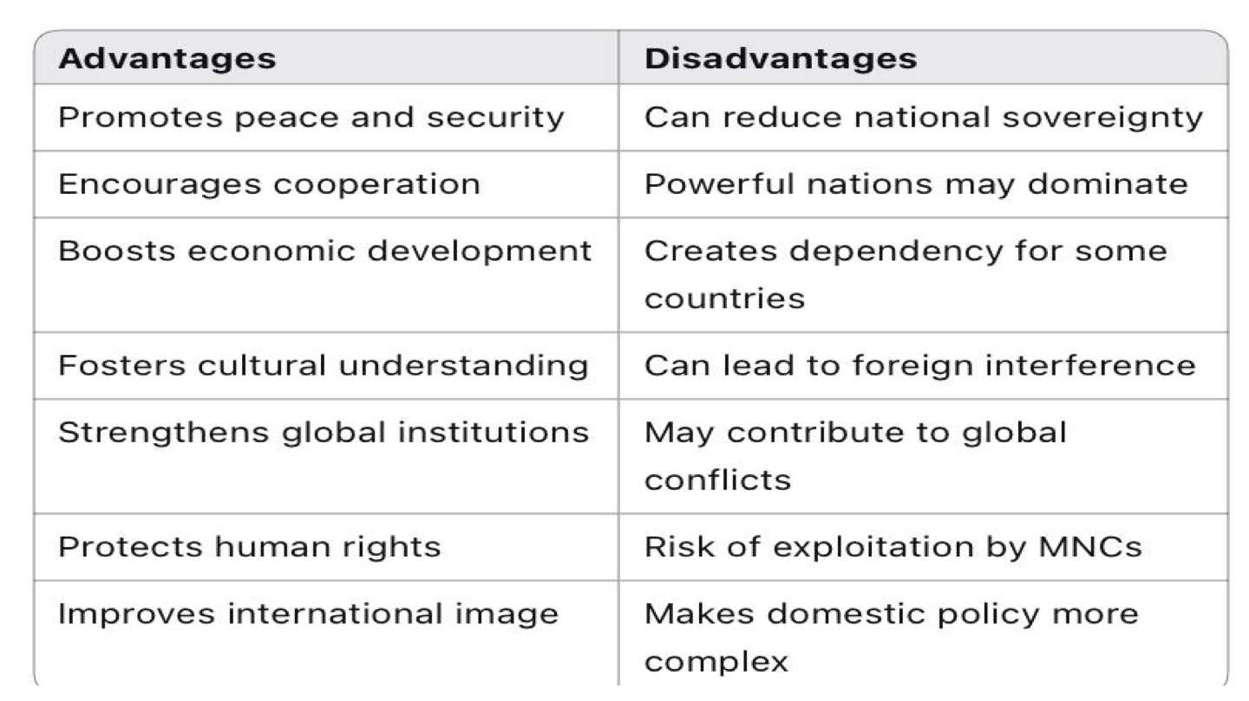

Slide 14
Evaluation of International Relations as a Separate Discipline
International Relations (IR) is the academic study of interactions among states, international organizations, non-state actors and global institutions within the international system. Traditionally, IR developed as a branch of Political Science but over the past century it has gradually evolved into a specialized field with its own theories, concepts and research methods. Scholars have long debated whether International Relations should be regarded as an independent academic discipline or merely a subfield of political science.
The debate became particularly prominent in the twentieth century when global events such as the two World Wars transformed the international system and encouraged systematic study of global politics. Since then, International Relations has developed a significant body of literature, specialized institutions and theoretical frameworks designed specifically to explain relations between states and other international actors.

Slide 15
Historical Development of International Relations
The systematic study of international politics is relatively recent compared to other social sciences. Early reflections on international affairs can be traced to classical thinkers such as Niccolò Machiavelli and Thomas Hobbes who discussed power, war and diplomacy. However, these ideas were not organized into a formal academic discipline.
The formal study of International Relations began after the devastation of World War I. The unprecedented destruction of the war highlighted the need to understand the causes of conflict and explore ways to maintain international peace. In response, universities and research institutions began establishing programs dedicated to the study of international politics.
A significant milestone occurred in 1919 with the creation of the first Chair of International Relations at the University of Wales, Aberystwyth in the United Kingdom. This marked the beginning of IR as a distinct academic field. The early scholars in this field were largely idealists who believed that international cooperation, diplomacy and international institutions could prevent future wars.
However, the outbreak of World War II challenged the optimistic assumptions of early idealist thinkers and led to the emergence of more pragmatic approaches, particularly realism. Since then, International Relations has evolved through several theoretical debates and methodological developments, gradually strengthening its academic identity.

Slide 16
2. Distinct Subject Matter of International Relations
One of the strongest arguments supporting International Relations as a separate discipline is its distinct subject matter. While political science generally focuses on domestic political systems, governance and political institutions within states, IR focuses on interactions among actors in the international system.
Key areas of study within IR
Foreign policy analysis
Diplomacy and negotiation
International conflict and security
International political economy
International law and organizations
Global governance and cooperation
These topics deal specifically with relationships among sovereign states and other global actors operating within an anarchic international system where there is no central authority. The unique characteristics of the international system require analytical frameworks that differ from those used in domestic politics.
Furthermore, IR studies actors beyond states, including international organizations, multinational corporations and non-governmental organizations. Organizations such as the United Nations and the World Trade Organization play important roles in shaping global political and economic relations.

Slide 17
3. Development of Distinct Theoretical Frameworks
Another major factor supporting the independence of IR is the development of its own theoretical traditions. Over the past century, scholars have proposed various theories to explain patterns of cooperation, conflict and power relations in the international system.
One of the most influential theories is Realism which emphasizes power, national interest and the anarchic nature of the international system. Realists argue that states pursue their own security and survival in a competitive environment where conflict is often unavoidable. Scholars such as Hans Morgenthau and Kenneth Waltz were central in developing realist thought.
In contrast, Liberalism emphasizes international cooperation, institutions and economic interdependence. Liberals argue that democratic governance, international organizations and global trade can reduce the likelihood of conflict and promote peace.
A more recent theoretical approach is Constructivism which focuses on the role of ideas, norms and identities in shaping international politics. Constructivists argue that international relations are socially constructed through shared beliefs and practices rather than determined solely by material power.
These theoretical frameworks provide specialized tools for analyzing global political processes, further reinforcing the intellectual independence of the field.

Slide 18
4. Methodological Approaches in International Relations
International Relations has also developed diverse methodological approaches that contribute to its disciplinary identity. Scholars employ both qualitative and quantitative methods to analyze global political phenomena.
Qualitative approaches include historical analysis, case studies and interpretive methods that examine diplomatic negotiations, foreign policy decisions and international institutions. Quantitative approaches involve statistical analysis, formal modeling and data driven studies of conflict, trade and cooperation among states.
Additionally, the study of international relations often requires comparative and interdisciplinary methods that integrate insights from economics, sociology, geography and law. For example, research on international trade draws heavily from economic theories while studies of international law rely on legal frameworks and institutional analysis.
Although these methods overlap with those used in political science, the specific focus on global processes gives IR a distinctive methodological orientation.

Slide 19
5. Interdisciplinary Nature of International Relations
One notable characteristic of International Relations is its interdisciplinary nature. The field integrates concepts and methods from several other academic disciplines, including economics, history, sociology, law and geography.
For instance, the study of international political economy examines the interaction between global markets and political power. Similarly, research on international law explores the legal frameworks governing relations among states and international organizations.
This interdisciplinary approach allows scholars to analyze complex global issues such as climate change, migration, terrorism and economic globalization. However, critics argue that this reliance on other disciplines weakens IR’s claim to full independence.
Nevertheless, supporters of IR’s autonomy contend that the integration of diverse perspectives actually strengthens the field by enabling comprehensive analysis of global politics.

Slide 20
6. Institutional Development and Academic Recognition
Institutional development is another important factor in evaluating IR as a separate discipline. Over the past century, universities around the world have established specialized departments and schools dedicated to international relations and global studies.
Numerous academic journals, research institutes and professional associations now focus specifically on international relations. These institutions provide platforms for scholarly debate, research dissemination and academic collaboration.
International organizations and policy institutions also contribute to the development of the field by providing empirical data and practical insights into global governance. As a result, IR has become one of the most dynamic and widely studied fields within the social sciences.
The existence of specialized academic programs and research networks indicates that IR has achieved a level of institutional maturity consistent with other independent disciplines.

Slide 21
7. Arguments Against the Independence of International Relations
Despite these developments, some scholars remain skeptical about treating International Relations as a completely independent discipline. They argue that International Relation still relies heavily on political science for its conceptual and methodological foundations.
First, many of the core concepts used in IR such as power, authority and governance originate from political theory and political science. These shared concepts suggest that International Relation may simply represent the study of politics at the international level rather than a fundamentally distinct field.
Second, critics argue that the interdisciplinary nature of IR indicates that it lacks a clearly defined methodological identity. Because it borrows theories and methods from economics, sociology and law. IR may be better understood as a multidisciplinary area of study rather than a separate discipline.
Third, many universities continue to organize IR programs within political science departments. This institutional arrangement reinforces the perception that IR remains a subfield rather than a fully independent discipline.

Slide 22
At End
The evaluation of International Relations as a separate discipline reveals both strengths and limitations in its claim to independence. On one hand, the field has developed a distinct subject matter, specialized theoretical frameworks and significant institutional infrastructure. These characteristics demonstrate that IR has evolved into a mature academic field capable of analyzing complex global political phenomena.
On the other hand, its historical origins within political science and its interdisciplinary nature suggest that it remains closely connected to other social sciences. The overlapping concepts and methodologies between IR and political science make it difficult to draw a clear boundary between the two fields.
Therefore, International Relations can best be understood as a semi autonomous discipline one that maintains strong intellectual connections with political science while possessing its own theories, research agenda and academic institutions. As global politics becomes increasingly complex in the twenty first century, the importance of International Relations as a specialized field of study will continue to grow.

Slide 23
Idealist Approach to the Study of International Relations
The Idealist Approach is one of the earliest theoretical perspectives in International Relations. It emerged mainly after the devastating consequences of World War I when scholars and political leaders sought ways to prevent future wars and establish lasting peace in the international system. Idealism emphasizes international cooperation, moral values, diplomacy and the role of international institutions in maintaining global peace and stability.
Meaning and Concept of Idealism: The Idealist approach, sometimes referred to as utopianism, argues that war is not inevitable and that peace can be achieved through rational policies, ethical principles and effective international organizations. Idealists believe that human beings are capable of cooperation and that international politics should be guided by morality, law and justice rather than power and conflict.
This approach emphasizes that states should pursue collective interests and peaceful relations instead of narrow national interests.
Historical Background : The Idealist approach gained prominence in the period between the two World Wars (1919–1939). After the destruction caused by World War I. Many scholars believed that international cooperation and democratic governance could prevent future conflicts.
One of the most influential supporters of Idealism was Woodrow Wilson, the President of the United States. Wilson proposed the Fourteen Points which emphasized principles such as self-determination, open diplomacy and the establishment of international organizations to maintain peace.
These ideas led to the creation of the League of Nations in 1919 which aimed to promote collective security and resolve international disputes through diplomacy.

Slide 24
Main Principles of Idealism
1. Importance of International Law
Idealists believe that international law should regulate the behavior of states. By following legal norms and agreements, countries can avoid conflicts and maintain peaceful relations.
2. Role of International Organizations
International organizations play a key role in maintaining global peace and cooperation. Institutions such as the United Nations are seen as mechanisms for resolving disputes and promoting international collaboration.
3. Promotion of Democracy
Idealists argue that democratic states are less likely to engage in war with each other. Therefore, the spread of democracy can contribute to global peace.
4. Collective Security
The principle of collective security suggests that aggression against one state should be treated as aggression against all states. This concept was central to the League of Nations system.
5. Moral and Ethical Values
Idealists emphasize that international politics should be guided by ethical principles such as justice, cooperation and respect for human rights.

Slide 25
Contributions of the Idealist Approach
The Idealist approach made several important contributions to the study and practice of international relations:
It introduced the idea that international politics could be regulated through institutions and law.
It encouraged the establishment of international organizations to manage global conflicts.
It promoted the importance of diplomacy and peaceful conflict resolution.
It laid the foundation for modern concepts such as global governance and international cooperation.
Criticism of Idealism
Despite its positive vision, the Idealist approach has been criticized for being overly optimistic and unrealistic.
First - Critics argue that Idealism underestimates the role of power and national interest in international politics. This criticism became stronger after the failure of the League of Nations to prevent World War II.
Second - Scholars associated with Realism argue that states primarily pursue their own security and interests, making conflict unavoidable in an anarchic international system.
Third - Idealism is often criticized for assuming that international institutions alone can maintain peace without considering the political and military realities of global power politics.

Slide 26
Merits. Idealist Approach
Emphasizes international law, morality and ethical conduct.
Promotes international cooperation and diplomacy.
Encouraged the creation of institutions like the UN and League of Nations.
Supports democratic governance and collective security.
Demerits Idealist Approach
Overly optimistic and unrealistic.
Ignores the role of power and national interest.
Failed to predict or prevent major conflicts like WWII.

Slide 27
Importance Idealist Approach
Promotes the idea of peaceful resolution of conflicts.
Emphasizes international law, ethics and morality in global politics.
Encourages the formation of international organizations like the UN.
Advocates collective security and cooperation among states.
Supports democratic principles and human rights globally.

Slide 28
Realist Approach to the Study of International Relations
The Realist approach is one of the most influential perspectives in International Relations. It emerged as a reaction against the optimistic assumptions of the Idealism approach, particularly after the failure of international institutions to prevent World War II. Realism emphasizes power, national interest, security and the anarchic nature of the international system. According to realists, international politics is essentially a struggle for power among states seeking to ensure their survival.
Meaning and Concept: The Realist approach argues that international relations are governed primarily by power politics and national interests rather than moral principles or international law. Realists believe that the international system lacks a central authority therefore, each state must rely on its own capabilities to protect its sovereignty and security.
In this perspective, states are considered the most important actors in world politics, and they behave rationally to maximize their power and influence.
Historical Background: The intellectual roots of realism can be traced to classical thinkers such as, Niccolò Machiavelli and Thomas Hobbes, who emphasized power, conflict and the competitive nature of political life.
In the twentieth century, modern realism was strongly developed by scholars like Hans Morgenthau and later by Kenneth Waltz. Morgenthau’s work Politics Among Nations became a foundational text explaining how states pursue power and national interests in international politics.

Slide 29
Main Principles of the Realist Approach
1. State Centric Perspective
Realists consider the state as the primary actor in international relations. Other actors such as international organizations have limited influence compared to sovereign states.
2. National Interest
States act primarily to protect and promote their national interests, especially security and survival.
3. Power Politics
Power is the central concept in realism. States compete to increase their military, economic and political power in order to secure their position in the international system.
4. Anarchy in the International System
Realists argue that the international system is anarchic, meaning there is no global government to enforce rules. Therefore, states must depend on self help to maintain their security.
5. Balance of Power
To prevent domination by a single state, countries often form alliances to maintain a balance of power in the international system.
Contributions of the Realist Approach
The Realist approach has made several important contributions to the study of international relations:
It provides a realistic explanation of conflict and competition among states.
It highlights the importance of power and security in global politics.
It helps explain military alliances, arms races, and strategic rivalries.
It offers insights into foreign policy decision-making and geopolitical strategies.
Realism has been particularly influential in understanding global power dynamics during periods such as the Cold War.

Slide 30
Criticism of the Realist Approach
Despite its influence, realism has been criticized by many scholars.
First critics argue that realism focuses too heavily on conflict and power while ignoring the potential for cooperation and international institutions.
Second realism tends to underestimate the role of international organizations such as the United Nations in promoting global governance and cooperation.
Third some scholars argue that realism overlooks the influence of economic interdependence, international norms, and non-state actors in contemporary global politics.

Slide 31
Merits Realist Approach
Provides a practical explanation of international politics.
Highlights power, security, and national interest.
Explains conflict, alliances, and strategic behavior.
Useful for understanding geopolitics and wars.
Demerits
Too pessimistic and conflict-focused.
Ignores international cooperation and institutions.
Overlooks the role of non-state actors and economic factors

Slide 32
Importance Realist Approach in IR
Provides a practical understanding of global politics based on power and security.
Helps analyze conflicts, wars, and alliances among states.
Explains national interest and power dynamics in international relations.
Useful in understanding geopolitics and strategic competition.
Highlights the anarchic nature of the international system.

Slide 33
Liberal Approach to the Study of International Relations
The Liberal approach is one of the major perspectives in International Relations. It developed partly as a continuation of the ideas of Idealism and emphasizes international cooperation, democracy, economic interdependence and the role of international institutions in maintaining peace. Liberal thinkers believe that despite the anarchic nature of the international system, cooperation among states is possible and can lead to stable and peaceful international relations.
Meaning and Concept :The Liberal approach argues that international politics is not only a struggle for power but also a field where cooperation and mutual benefits can be achieved. Liberals believe that states can work together through diplomacy, trade and international organizations to resolve conflicts and promote global stability.
Unlike the Realism approach, which focuses mainly on power and security, liberalism highlights the importance of economic cooperation, democratic governance and international norms.
Historical Development:The intellectual roots of liberalism can be traced to philosophers such as Immanuel Kant and John Locke, who emphasized individual freedom, rule of law and peaceful cooperation among societies.
In modern international relations, liberal ideas gained importance after the formation of international institutions designed to promote peace and cooperation. Organizations such as the United Nations and the World Trade Organization reflect liberal principles of international cooperation and institutional governance.

Slide 34
Main Principles of the Liberal Approach
1. Importance of International Institutions
Liberals believe that international organizations help manage conflicts and facilitate cooperation among states. Institutions provide rules, norms and platforms for negotiation and dialogue.
2. Economic Interdependence
Liberalism emphasizes that trade and economic cooperation create mutual benefits and reduce the likelihood of conflict between states.
3. Democratic Peace Theory
One important liberal idea is that democratic states are less likely to go to war with each other. Therefore, the spread of democracy contributes to international peace.
4. Cooperation and Collective Interests
Liberals argue that states are capable of cooperation because they recognize common interests such as economic growth, environmental protection and global security.
5. Role of Non-State Actors
Unlike realism, liberalism recognizes the growing importance of international organizations, multinational corporations and non-governmental organizations in global politics.

Slide 35
Contributions of the Liberal Approach
The Liberal approach has made significant contributions to the understanding of international relations:
It highlights the importance of international institutions and global governance.
It explains the role of trade and economic cooperation in maintaining peace.
It recognizes the influence of non-state actors in international politics.
It promotes diplomatic solutions and multilateral cooperation.
These ideas are reflected in many international institutions and agreements that regulate global economic and political relations.
Criticism of the Liberal Approach
Despite its contributions, the liberal approach has been criticized by some scholars.
First, critics argue that liberalism underestimates the role of power and national interests in international politics, which are emphasized by realism.
Second, economic interdependence does not always prevent conflicts, as states may still compete for strategic advantages.
Third, some scholars argue that international institutions often reflect the interests of powerful states rather than promoting equal cooperation among all countries.

Slide 36
Merits of the Liberal Approach in IR
Highlights cooperation, democracy and global institutions.
Explains the role of trade and economic interdependence.
Encourages peaceful conflict resolution through diplomacy.
Recognizes the importance of international organizations.
Demerits of the Liberal Approach in IR
Overestimates cooperation among states.
Institutions may favor powerful states over weaker ones.
May underestimate security and powerful struggles

Slide 37
Importance of the Liberal Approach in IR
Highlights the importance of cooperation and diplomacy among states.
Explains the role of international institutions and organizations.
Shows how economic interdependence reduces conflict.
Promotes democracy, human rights and global governance.
Encourages multilateral solutions to global issues.

Slide 38
Neo-Liberal Approach to the Study of International Relations
The Neo-Liberal approach, often called Neoliberal Institutionalism, is an important modern perspective in International Relations. It developed during the late twentieth century as a refinement of classical Liberalism. Neo-liberalism seeks to explain how cooperation among states is possible even in an anarchic international system.
While neo-liberal scholars accept some of the assumptions of Realism such as the absence of a central global authority they argue that international institutions, economic interdependence and rules can facilitate cooperation and reduce conflict among states.
Meaning and Concept :The Neo-Liberal approach emphasizes that states are rational actors seeking to maximize their interests but they also recognize that cooperation can provide mutual benefits. Therefore, states often create institutions and international regimes that regulate their behavior and promote stability in global politics.
Neo-liberal scholars argue that international organizations help states overcome problems such as mistrust, lack of information and fear of cheating in cooperative arrangements.
Historical Development: Ne Liberalism gained prominence in the 1970s and 1980s, particularly in response to realist theories that emphasized power politics and conflict. Scholars attempted to explain why states continued to cooperate in areas such as trade, finance and environmental protection despite the absence of a world government.
Prominent scholars associated with the neo-liberal approach include Robert Keohane and Joseph Nye. Their work emphasized the importance of international regimes and institutions in shaping state behavior and facilitating cooperation.

Slide 39
Key Principles of the Neo-Liberal Approach
1. Importance of International Institutions
Neo-liberals argue that international institutions play a crucial role in promoting cooperation by providing rules, norms and mechanisms for dispute resolution. Organizations such as the United Nations and the World Trade Organization help regulate relations among states.
2. Economic Interdependence
Neo-liberalism emphasizes the growing economic interconnectedness of countries through trade, investment, and global markets. This interdependence encourages states to cooperate because conflict would harm their economic interests.
3. Absolute Gains
Unlike realism, which focuses on relative gains, neo-liberalism argues that states are often concerned with absolute gains, meaning they are willing to cooperate if all participants benefit from the arrangement.
4. International Regimes and Rules
International regimes sets of rules and norms governing specific issue areas help coordinate state behavior and reduce uncertainty in international relations.
5. Role of Non-State Actors
Neo-liberalism recognizes that multinational corporations, international organizations and non-governmental organizations influence global politics alongside states.

Slide 40
Contributions of the Neo-Liberal Approach
The Neo-Liberal approach has made several important contributions to the study of international relations:
It explains how cooperation can occur even in an anarchic international system.
It highlights the role of international institutions and regimes in maintaining global order.
It emphasizes the importance of globalization and economic interdependence.
It provides insights into the functioning of international organizations and global governance.
Criticism of Neo Liberalism
Despite its contributions, the neo-liberal approach has faced several criticisms.
First, realist scholars argue that neo-liberalism underestimates the role of power and security competition in international politics.
Second, critics claim that international institutions often reflect the interests of powerful states and therefore cannot ensure equal cooperation among all countries.
Third, Neo-liberalism may overlook the importance of ideological, cultural, and identity factors in international relations which are emphasized by other theories such as constructivism.

Slide 41
Merits of the Neo-Liberal Approach
Explains cooperation even in an anarchic system.
Emphasizes international institutions and regimes.
Focuses on absolute gains rather than relative gains.
Accounts for globalization and economic interdependence.
Demerits of the Neo-Liberal Approach
Underestimates power politics and security concerns.
Institutions may serve dominant states’ interests.
Less attention to ideological and cultural factors.

Slide 42
Importance of the Neo-Liberal Approach in IR
Explains cooperation even in an anarchic system.
Emphasizes international institutions and regimes.
Focuses on absolute gains rather than relative gains.
Accounts for globalization and economic interdependence.
Underestimates power politics and security concerns.
Institutions may serve dominant states’ interests.

Slide 43
Marxist Approach to the Study of International Relations
The Marxist approach is an important critical perspective in International Relations. It is based on the ideas of Karl Marx and Friedrich Engels who analyzed the role of economic structures and class relations in shaping political and social systems. In international relations, the Marxist approach focuses on how global capitalism, economic exploitation and class struggle influence relations among states and the structure of the international system.
Unlike realist or liberal theories that focus mainly on states and power politics, the Marxist perspective emphasizes economic factors and the global capitalist system as the primary forces shaping international relations.
Meaning and Concept: The Marxist approach argues that international politics cannot be fully understood without analyzing the economic system of capitalism and the inequalities it creates between countries. According to this perspective, the international system is divided between developed capitalist countries and developing or dependent countries.
Marxists believe that powerful capitalist states exploit weaker nations economically through trade, investment and control of resources. As a result, international relations reflect the interests of dominant economic classes rather than the interests of all people.
Historical Background: The intellectual foundation of the Marxist approach comes from the works of Karl Marx, particularly his analysis of capitalism in Das Kapital. Marx argued that capitalism creates class divisions between the bourgeoisie (owners of capital) and the proletariat (working class).
In the twentieth century, Marxist scholars extended these ideas to international relations. Thinkers such as Vladimir Lenin argued that imperialism was the highest stage of capitalism and that powerful capitalist states expand their influence over weaker regions to secure resources and markets.
Later theories such as dependency theory and world systems theory further developed the Marxist interpretation of global politics.

Slide 44
Key Principles of the Marxist Approach
1. Economic Determinism
The Marxist approach argues that economic structures determine political relations. International politics is largely shaped by global capitalist economic relations.
2. Class Conflict
Marxists believe that class struggle is the driving force of history. In international relations, this conflict extends beyond national borders, creating divisions between rich and poor countries.
3. Imperialism and Exploitation
Powerful capitalist states expand their influence through imperialism, controlling resources, labor and markets in weaker countries.
4. Global Inequality
The international system is characterized by inequality between developed and developing countries. Wealthy nations benefit from global economic structures, while poorer nations often remain dependent.
5. Critique of Capitalism
Marxists argue that capitalism creates instability and conflict in the international system. They believe that lasting peace can only be achieved through fundamental changes in the global economic structure.

Slide 45
Contributions of the Marxist Approach
The Marxist perspective has contributed significantly to the study of international relations by:
Highlighting the role of economic inequality in global politics.
Explaining patterns of colonialism, imperialism, and economic dependency.
Drawing attention to the impact of global capitalism on developing countries.
Encouraging critical analysis of international economic institutions and global power structures.
These ideas have influenced later theories such as dependency theory and world systems analysis.
Criticism of the Marxist Approach
Despite its contributions, the Marxist approach has been criticized by many scholars.
First, critics argue that Marxism places too much emphasis on economic factors and neglects political, cultural and ideological influences in international relations.
Second, the theory often underestimates the importance of states and national interests, which are central elements in other approaches such as realism.
Third, some scholars argue that global politics cannot be explained solely by capitalist exploitation because cooperation and development have also occurred in many regions.

Slide 46
Merits- Marxist Approach in IR
Highlights economic inequality and exploitation.
Explains imperialism and dependency in global politics.
Analyzes the role of capitalism in international relations.
Encourages critical perspectives on global power structures.
Demerits of Marxist Approach
Overemphasis on economic factors.
Underestimates political, security, and cultural aspects.
Less attention to state

Slide 47
Importance of Marxist Approach
Highlights the economic and class dimensions of international relations.
Explains imperialism, dependency, and exploitation in the global system.
Encourages critical analysis of capitalism and inequality.
Helps understand global economic structures influencing politics.
Provides perspective on global social justice and development issues.

Slide 48
Constructivist Approach to the Study of International Relations
The Constructivist approach is a relatively recent and influential perspective in International Relations. It emerged in the late twentieth century as an alternative to dominant theories such as Realism and Liberalism . Constructivism focuses on the role of ideas, norms, identities and social interactions in shaping international politics.
Unlike realism and liberalism, which emphasize material factors such as military power and economic interests, constructivism argues that the international system is socially constructed through shared beliefs and practices.
Meaning and Concept : Constructivism suggests that international relations are not determined solely by material power or economic interests but are shaped by social and ideational factors. According to this approach, the behavior of states depends on how they interpret the international environment and how they define their identities and interests.
Constructivists argue that norms, values and shared ideas influence the actions of states and international actors. Therefore, international politics is shaped by social interactions and collective meanings rather than by objective structures alone.
Historical Development: Constructivism gained prominence in the 1980s and 1990s as scholars sought to explain changes in international politics that traditional theories could not fully account for, such as the peaceful end of the Cold War.
One of the most influential scholars of constructivism is Alexander Wendt whose famous argument “anarchy is what states make of it” emphasized that the nature of the international system depends on how states interpret and respond to it.

Slide 49
Key Principles of the Constructivist Approach
1. Social Construction of International Reality
Constructivists believe that the structures of international politics are created and maintained through social interactions among states and other actors.
2. Importance of Norms and Ideas
International norms and shared ideas shape the behavior of states. These norms influence how states perceive threats, cooperation and legitimacy.
3. Role of Identity
Constructivism emphasizes that a state's identity affects its foreign policy and international behavior. For example, states that identify as democratic or peaceful may behave differently from those with authoritarian identities.
4. Dynamic Nature of International Relations
Constructivists argue that international politics is not fixed; it can change over time as ideas, norms and identities evolve.
5. Influence of Non-State Actors
Constructivism recognizes the role of international organizations, advocacy groups and social movements in shaping global norms and policies.

Slide 50
Contributions of the Constructivist Approach
The Constructivist approach has made important contributions to the study of international relations:
It highlights the importance of norms, values and ideas in global politics.
It explains how international norms such as human rights and environmental protection emerge and spread.
It helps understand changes in international relations that cannot be explained by power or economic factors alone.
It emphasizes the role of social interaction in shaping international cooperation and conflict.
Criticism of the Constructivist Approach
Despite its contributions, constructivism has faced several criticisms.
First, critics argue that constructivism is sometimes too abstract and difficult to test empirically.
Second, some scholars believe that it underestimates the importance of material factors such as military power and economic resources.
Third, critics argue that constructivism may not provide clear predictions about state behavior in international politics.

Slide 51
Merits - Constructivist Approaches
Emphasizes the role of ideas, norms, and identities.
Explains how international norms influence state behavior.
Accounts for changes in global politics over time.
Recognizes non-state actors and social interactions.
Demerits
Abstract and difficult to test empirically.
Underestimates material factors like power and resources.
Provides limited predictive power for state behavior.

Slide 52
Importance of Constructivist approaches in IR
Emphasizes the role of ideas, norms and identities in shaping international behavior.
Explains how international norms and social structures evolve.
Recognizes the influence of non-state actors and global networks.
Accounts for changes in international politics over time.
Helps understand peaceful transformations and social constructs in global affairs.

